Slide 1
Secure Coding – Midterm review
Joseph Patarcity
joseph.patarcity@rutgers.edu

Slide 2
Notes
All code examples are simple snippets used to illustrate bad programming behaviors; therefore, these code samples will not compile without some extra work.
When answering questions, focus on fixing the cybersecurity problem, not the problem of making the code compile.
Any questions, please email me!

Slide 3
Secure Coding
Secure Coding is a subset of Defensive Programming
Defensive Programming is Data Validation across Trust Boundaries
Trust Boundaries include, but are not limited to …
Command Line Input
Shared Memory
Input from Files
Network Sockets
Secure Coding is the technique of treating Computer Science problems as Computer Security problems.
Simple defects, bugs and logic flaws are vulnerabilities.
Vulnerabilities can be exploited under the right conditions to allow an attacker to make a computer program behave in a way that the developer did not intend.
Performing Risk Assessment when a defect, bug or logic flaw is discovered can help prioritize the likelihood and severity of the potential exploit.

Slide 4
Buffer Overflow
There are three types of vulnerabilities related to mishandled character arrays (buffers) …
Buffer Overflow – the source data is larger than what can be stored in the destination array.
Off-by-One Error – A character array that represents a string (a character array does not necessarily have to represent a string) is not properly null terminated.
This results in either data truncation, or writing a null terminator to memory that doesn’t belong to the program.
Buffer Overread – A character array representing a string is not null terminated, and any C string function accessing the array will read from memory until a null terminator is encountered.
This can expose data on the heap or stack..
Memory allocation functions (malloc/free) allocate memory on the heap.
A Buffer Overflow can overwrite data that belong to another program, causing undefined behavior.
A Buffer Overread can expose data from other programs.
Local variables of a function, as well as the functions return pointer are stored on the stack.
Depending on ordering of declaration, a buffer overflow can overwrite local variables, or the return address of the function (function pointer).
Data validation is the best way to protect against a buffer overflow condition.

Slide 5
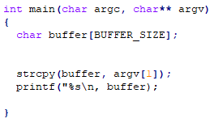
Buffer Overflow
The above code snippet contains several issues.
Buffer Overflow in unbounded strcpy() call.
Buffer Overread in printf() call.
Missing null termination.
Formatted Output vulnerability.
argv[1] can be NULL, don’t trust it!
Notes:
The main() function in any C program can take multiple arguments; argc holds the count of the number of arguments, **argv is a array of arguments which are considered character by C. Any type conversion is the programmers responsibility.

Slide 6
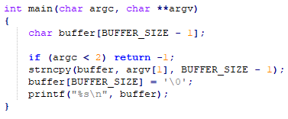
Buffer Overflow
The Formatted Output vulnerability is not being addressed in this example.
The Buffer Overflow, Buffer Overread and Off-by-One vulnerabilities are corrected by using strncpy() and manually setting the null pointer at the end of the string (BUFFER – 1).
If the number of arguments to this program is less than 2 (meaning argv[1] would be NULL) the program quits.

Slide 7
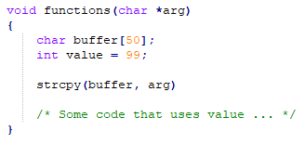
Buffer Overflow
In the event of a buffer overflow in the strcpy() call, the integer stored in “value” can be overwritten … this WILL result in undefined behavior if “value” is used elsewhere in the function.
In the event of a buffer overflow, strcpy() could also overwrite the return address of this function.
This could allow an attacker to put an arbitrary address in the place on the stack where return address resides, allowing for arbitrary code injection.
Notes:
Arbitrary code injection is typically shell code, that can be injected directly with an attack string, or store in memory such as an environment variable.
Special Note; this type of attack is more difficult because of ASLR (Address Space Layout Randomization) and by turning on stack protection with the –fstack-protector or –fstack-protector-all compiler flag options.

Slide 8
Formatted Output
Formatted Output vulnerabilities occur when both untrusted data contains string format characters (format modifiers) and formatted output functions (such as printf()) are used incorrectly.
Exploiting this vulnerability can produce the following conditions …
Reading from memory that does not belong to the program.
Allow usage of %n in the attack string to overwrite an arbitrary memory location, such as the address of printf() in the GOT (Global Offset Table)
Notes:
The compiler options –Wall or –Wformat will cause the GCC compiler to check that the number of format modifiers matches the number of variables passed to a formatted output function. This produces a compiler warning, but may also prevent to program from compiling.

Slide 9
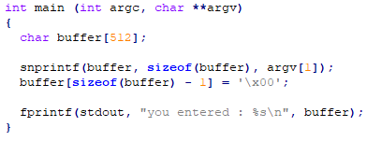

Formatted Output
The above code snippet contains a formatted output vulnerability.
The above check is good, but only protects against passing “%x” into the program.
The above check is BETTER if the “%” character is not valid input to this program.

Slide 10
Integer Overflow
Integer overflow occurs when that maximum value for a type is stored in a variable of that type.
This is considered undefined behavior because it depends on the compiler implementation to determine the result of an overflow operation.
A post-overflow integer overflow check is not always reliable because on some compilers the result may be the MIN value for a type, while on others it may be the MAX value for the type when an overflow occurs.
For unsigned integer overflows, the gcc compiler will set the resultant value to ZERO.
For signed integer overflows, the gcc compiler will set the value to the smallest number that can be stored in a signed integer.
For signed/unsigned long, the overflow behavior is the same as with signed/unsigned integers.
Notes:
Exploits of overflow conditions can be used to cause SIGSEGV (segmentation faults) in the case where the overflow arithmetic is used to allocate or re-allocate memory.

Slide 11
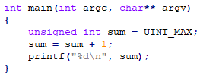
Integer Overflow
The sample code above will result in an integer overflow. The pre-overflow check will determine if there is enough “space” in sum to store UINT_MAX plus 1.
In the above line of code when the value to be added to sum (in this case 1) is greater than UINT_MAX minus sum, we know that a overflow will occur on the line “sum = sum + 1”.

Slide 12

Integer Overflow
In the above post-overflow check, we are relying on undefined behavior to determine if overflow has occurred.
This check is undesirable, as it’s not guaranteed to work the same when ported from one compiler to another (it’s OK for gcc, but maybe not the C/C++ compiler for Windows).

Slide 13
Memory Management
Memory management errors occur when allocation function calls and deallocation function calls are not properly paired together.
This results in a memory leak. A memory leak can be exploited to Denial of Service a system … any memory allocated on the heap, but not freed, will decrease the amount of memory available to other programs.
In C, a malloc() call should always have a corresponding free() call unless the memory has static allocation, in which case the memory is freed when the pointer to the memory goes out of scope.
A popular tool for checking memory leaks in C programs is valgrind. Valgrind is available with most Linux distributions.
Valgrind works like a virtual machine to detect when a program is leaking memory.

Slide 14
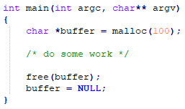
Memory Management
In the above code example, the allocation of buffer using malloc() will result in a memory leak if buffer is not freed with a call to free().
It is GOOD PRACTICE to set buffer to NULL when the program is finished with buffer, although NOT NECESSARY.
This is good practice because not all compilers will guarantee that buffer is NULL after a call to free(buffer), however it is guaranteed with gcc.

Slide 15
SEI CERT C Coding Standards
Review the following Required coding standards for C, as these relate directly to the vulnerabilities discussed in class.
https://wiki.sei.cmu.edu/confluence/display/c/STR31-C.+Guarantee+that+storage+for+strings+has+sufficient+space+for+character+data+and+the+null+terminator
https://wiki.sei.cmu.edu/confluence/display/c/STR32-C.+Do+not+pass+a+non-null-terminated+character+sequence+to+a+library+function+that+expects+a+string
https://wiki.sei.cmu.edu/confluence/display/c/INT30-C.+Ensure+that+unsigned+integer+operations+do+not+wrap
https://wiki.sei.cmu.edu/confluence/display/c/INT32-C.+Ensure+that+operations+on+signed+integers+do+not+result+in+overflow
https://wiki.sei.cmu.edu/confluence/display/c/FIO30-C.+Exclude+user+input+from+format+strings
https://wiki.sei.cmu.edu/confluence/display/c/MEM30-C.+Do+not+access+freed+memory
https://wiki.sei.cmu.edu/confluence/display/c/MEM31-C.+Free+dynamically+allocated+memory+when+no+longer+needed

Slide 16
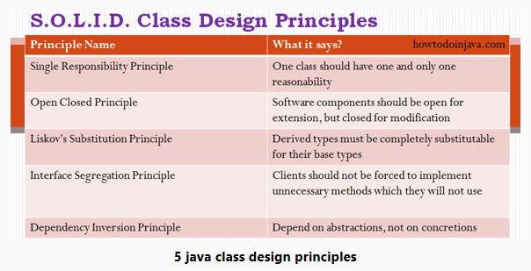
SOLID
Review the SOLID principles for Java here …
https://howtodoinjava.com/best-practices/5-class-design-principles-solid-in-java/

Slide 17
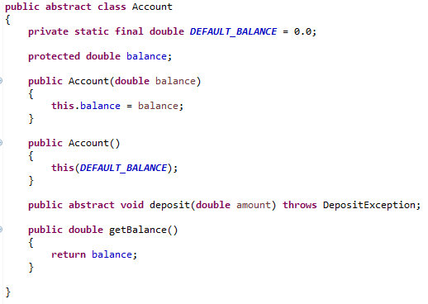
SOLID
This Java class applies the following SOLID principles.
Single Responsibility Principle.
The abstract Account class only operates on balance, to initialize it, return it, and modify it through deposit().
Open Closed Principle
This class allows derived classes to change the behavior of deposit().
Liskov’s Substitution Principle
Any derived class can be substituted for this abstract class.
Interface Segregating Principle
No method besides deposit() need be implemented by a class extending this class.

Slide 18
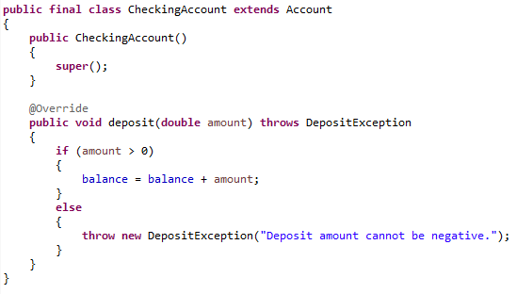
SOLID
This Java class applies the following SOLID principles.
Dependency Inversion Principle – This class depends on Account, which is abstract, rather than concrete.
Notes:
Special Note; this class is declared as final. This means that NO OTHER class can be derived from the CheckingAccount class. This has two purposes … 1) By design of the system, making this class final means conceptually there are no other types of checking accounts and 2) it protects this class from known Java vulnerabilities.

Slide 19
Bonus Questions
Watch WarGames.
Watch Jurassic Park.
Remember your professor is a huge Star Wars nerd.

